Slide 1
2.1 Density Curves
EQ: How do we approximate a distribution of data?

Slide 2
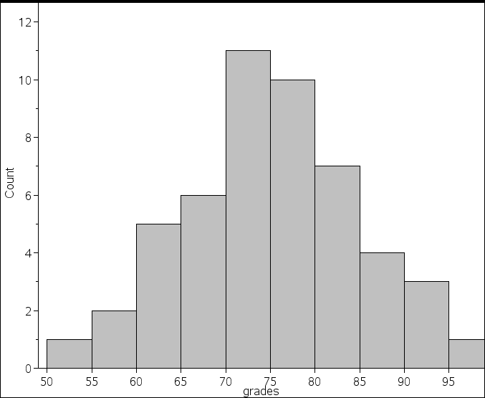
Grades of 50 students
What proportion of students
had scores below 70?
14/50 = 28%
2. What proportion of students
Had scores between 75 and 100?
25/50 = 50%
What would the grades of 100
Student look like? 500? 1000?

Slide 3
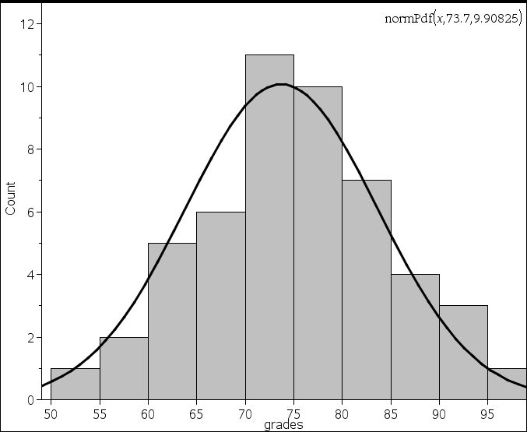
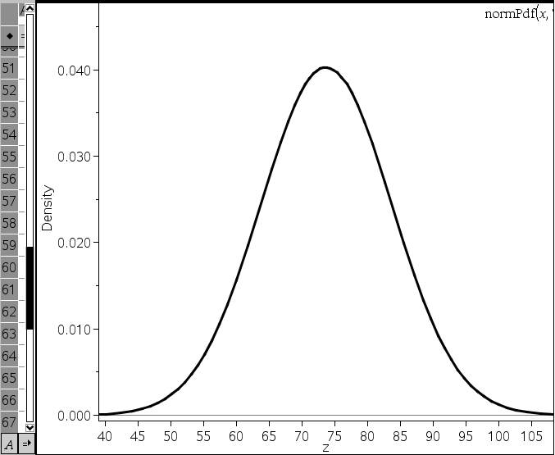
Density Curves
A curve which represents the shape of a distribution
The area underneath the entire curve is equal to 1.
The area within a certain interval represents the proportion of those events

Slide 4
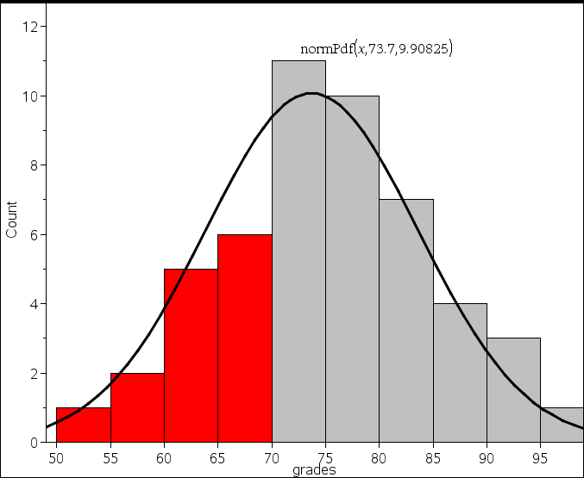
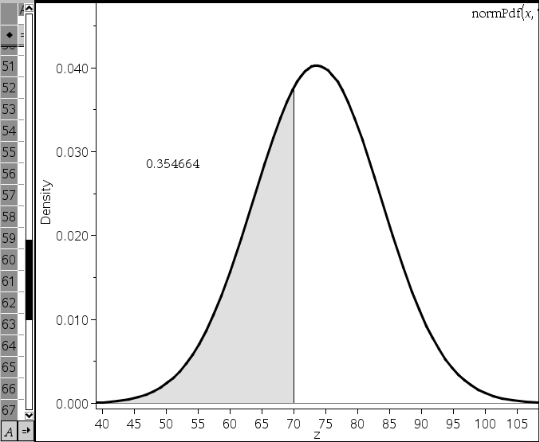
How density curves work
Sample
Population
What proportion of students had scores below 70?
14/50 = 28%
35.47%

Slide 5
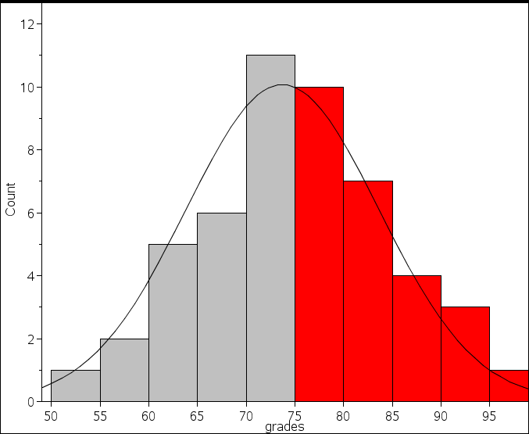
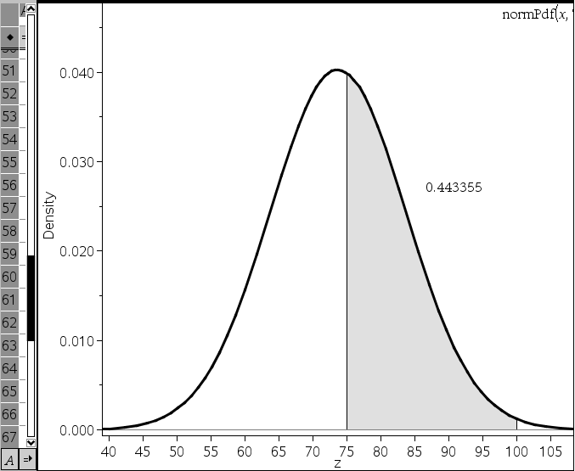
Sample
Population
What proportion of students had scores between 75 and 100?
25/50 = 50%
44.33%

Slide 6
Notation
Actual data (sample)
  Mean: Standard deviation:
Density curve (population)
  Mean Standard deviation:

Slide 7
Normal Distribution
A type of density curve that models many natural phenomena
Also known as the bell curve
Adjectives: symmetric, single peaked, mound shaped

Slide 8
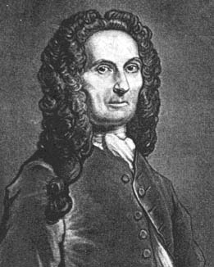
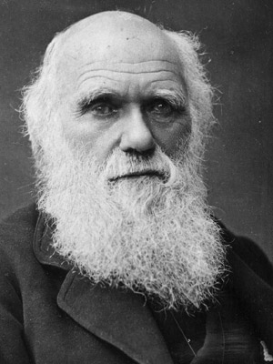
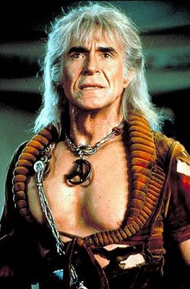

Slide 9
Using the normal curve
There are an infinite number of normal curves that can be constructed.
A normal curve is described by its mean and standard deviation.
  Notation:

Slide 10
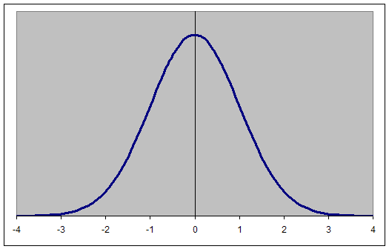
The Standard Normal curve
A normal curve whose mean is 0 and standard deviation is 1.

Slide 11
The Empirical rule:
A general rule that describe how much area is under the curve as measured by 1,2,or 3 standard deviations from the mean.

Slide 12
Areas under the curve
68%
95%
99.7%
.15%
2.35%
13.5%
34%
34%
13.5%
2.35%
.15%

Slide 13
Percentiles
.15%
2.35%
13.5%
34%
34%
13.5%
2.35%
.15%
0
.15
2.5
16
50
84
97.5
99.85
100

Slide 14
Army helmets: N(22.8,1.1)
19.5
20.6
21.7
22.8
23.9
25
26.1
Inches

Slide 15
Using the normal curve
The scores on the math portion of the SAT exam are normally distributed with a mean score of 500 and a standard deviation of 50. Draw the curve that represents the population of test takers scores.
350
400
450
500
550
600
650

Slide 16
350
400
450
500
550
600
650
What scores represent the middle 68% of test takers?
450-550
What scores represent the middle 95% of test takers?
400-600
What scores represent the middle 99.7% of test takers?
350-650
What percent of test takers scored lower than 450?
16 %
What percent of test takers scored better than 600?
2.5%

Slide 17
The length of human pregnancies from conception to birth varies according to a distribution that is approximately normal with mean 266 days and standard deviation 16 days.
Between what values do the lengths of the middle 95% of all pregnancies fall?
How short are the shortest 2.5% of all pregnancies?
How long are the longest 2.5% of all pregnancies?
218
234
250
266
282
298
314

Slide 18
Wechsler Adult Intelligence Scale (WAIS) scores for young adults are N(110,25).
If someone’s score was reported as the 16th percentile, about what score would that individual have? Answer the same question for the 84th percentile and the 97.5th percentile.
35
60
85
110
135
160
185

